Slide 1
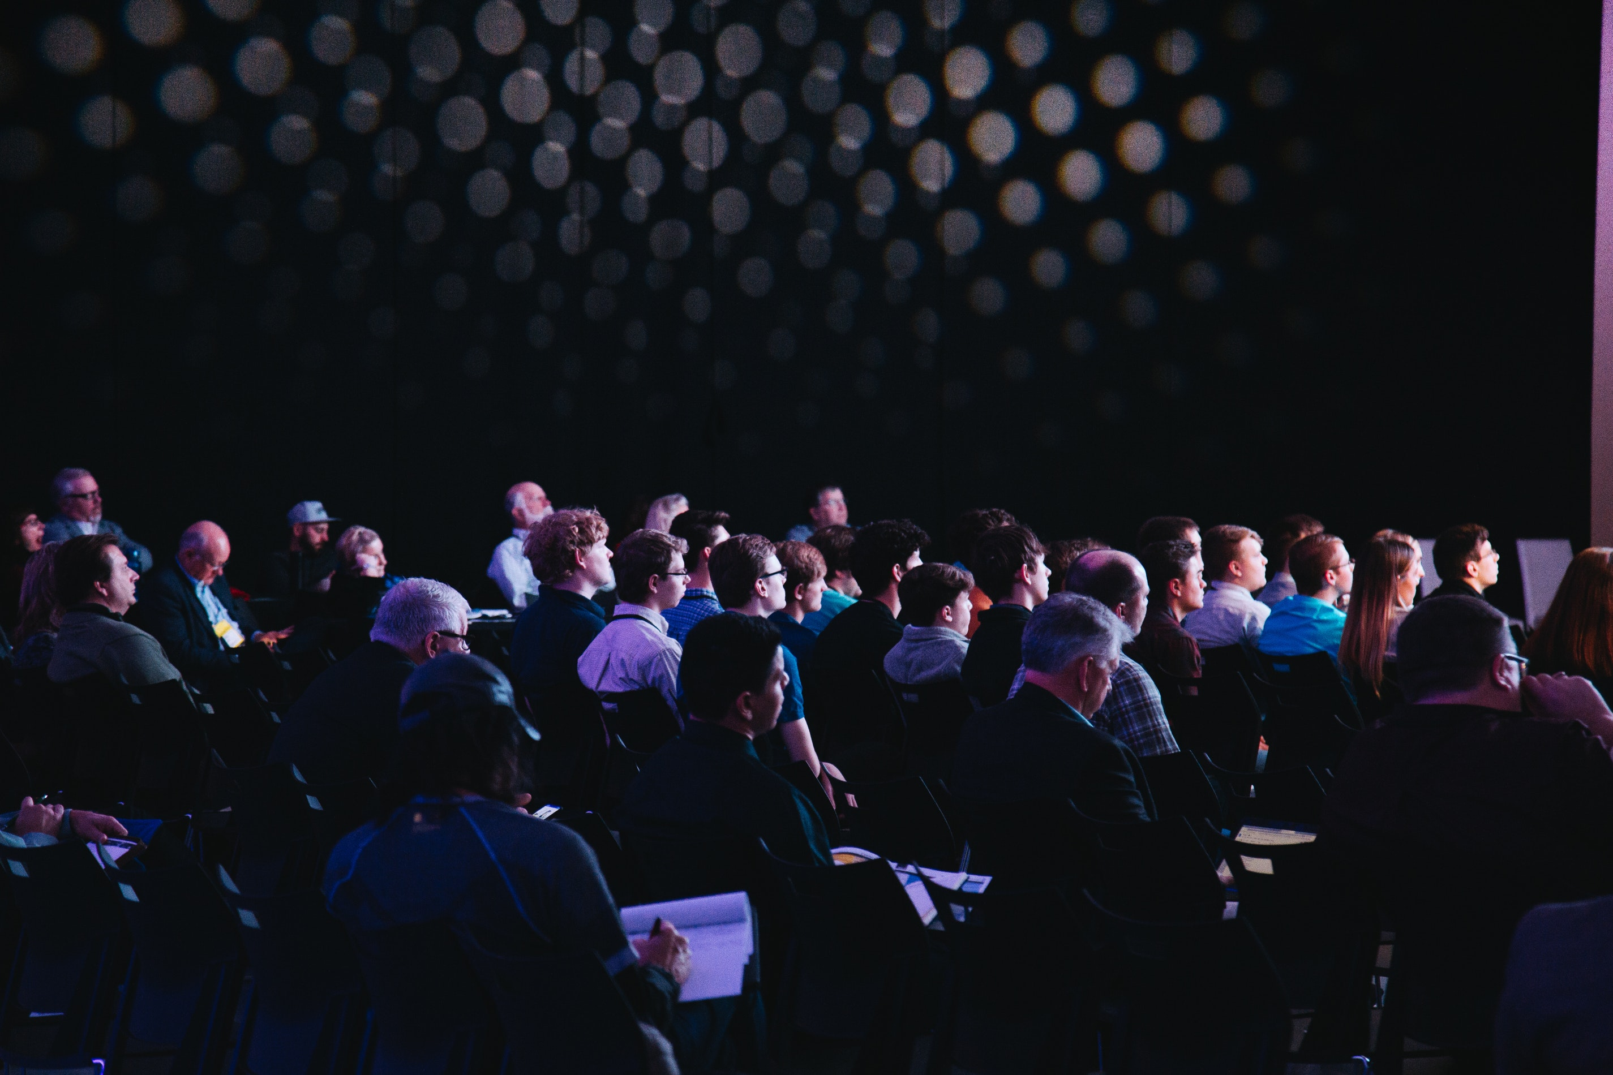

Testoper Codeathon Preparation - Session 001
1

Slide 2
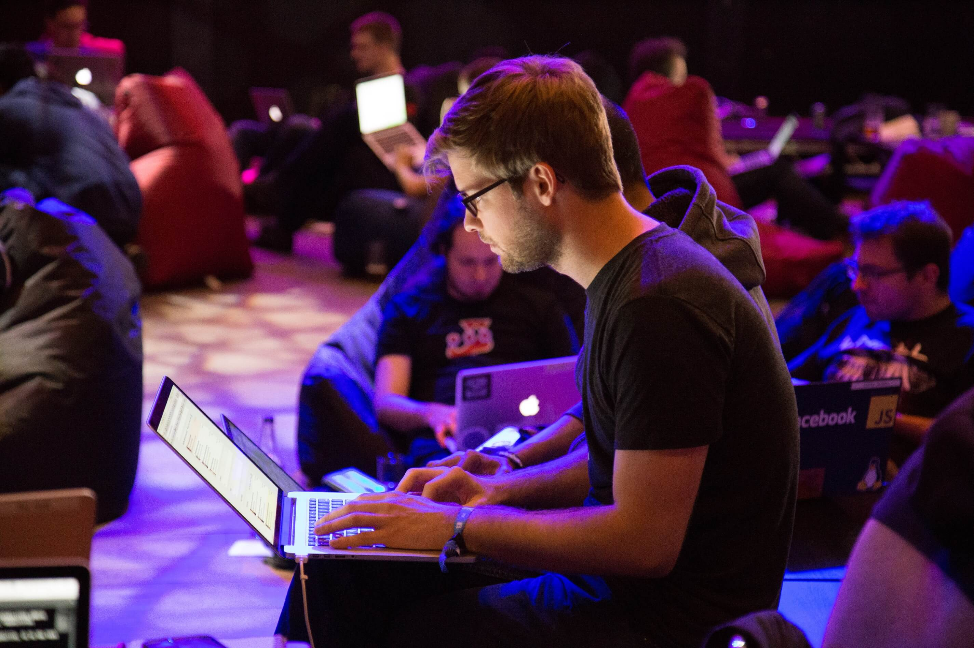
Why Testoper?

Slide 3

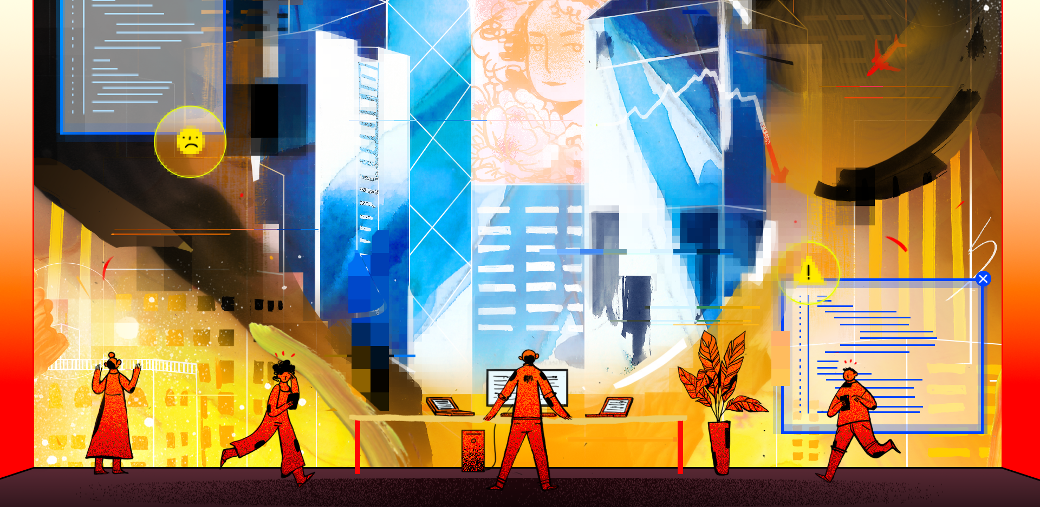
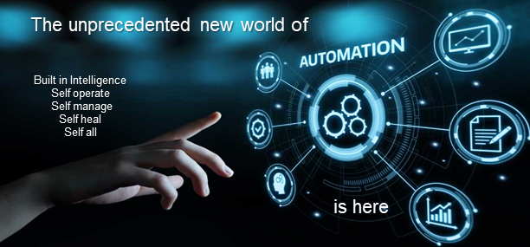
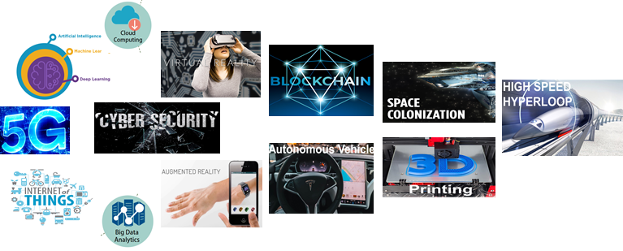
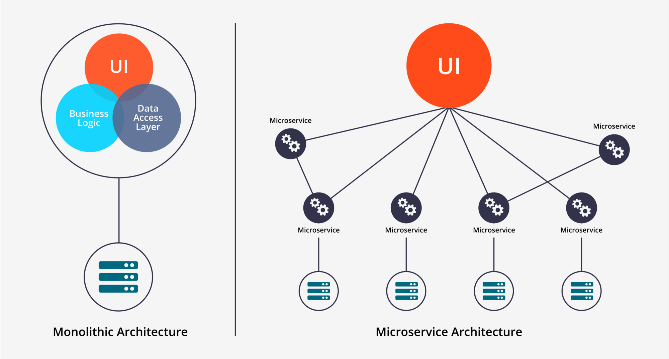
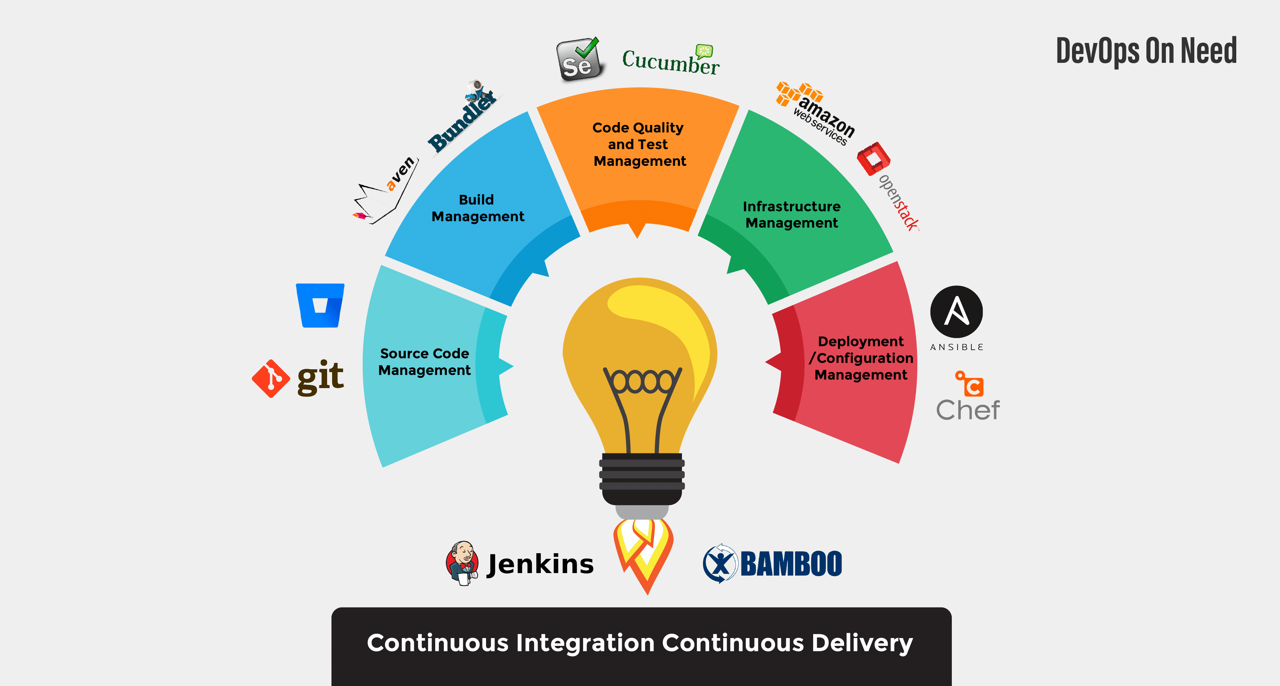
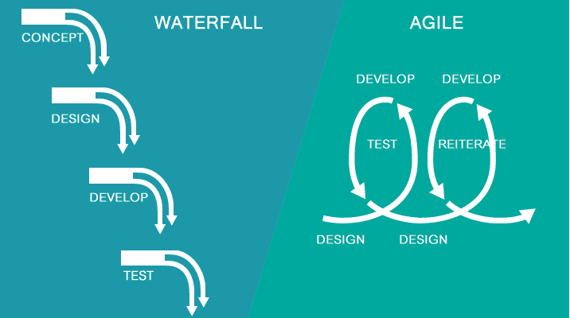
1
2
Imagine a world without “Delivering and Operating High-Quality Product”
To reap real automation benefit, “we now have to tackle complexity”
Dangerous world of chaos, monetary, and human loss
The digital transformation comes with greater complexity
Technological advancement
Architectural advancement
Technical advancement
Process advancement
3

Slide 4


More than ever given the complexity calls for smarter and creative talent for “delivering and operating high-quality product”;
calls for disruptive Innovation, unprecedented Intrapreneurship and Entrepreneurship;
the world needs a little more of from you (AIM);
the world needs a Testoper;

Slide 5
About Testoper

Slide 6



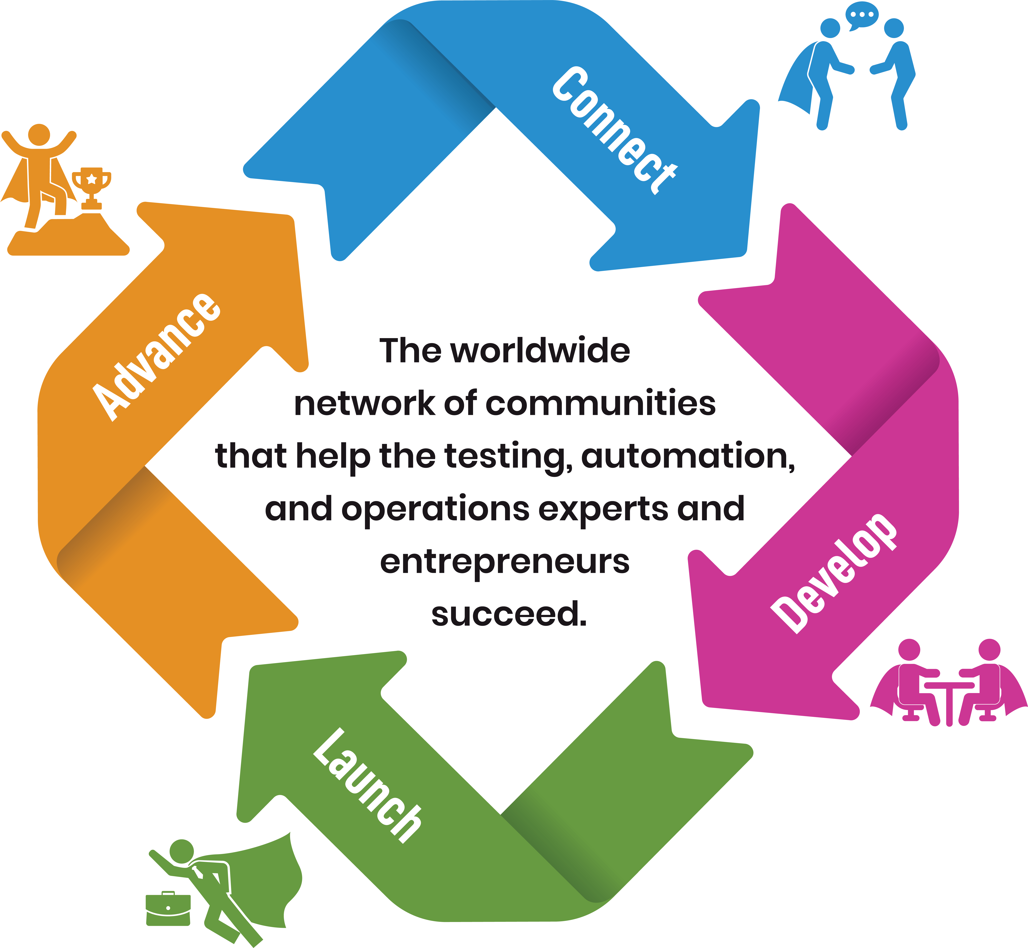
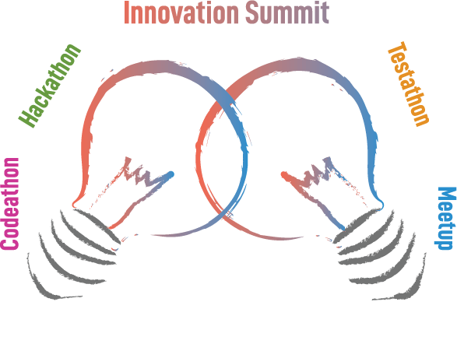
We enable creative talent to accelerate the pace of innovation for delivering and operating high-quality products. As a result, we empower enterprise, government, academics, and individuals to create social impact and economic growth.
6
Notes:
Social impact - well being of individuals and families, livability and oppurtunities
Economic Growth - is an increase in the production of goods and services in an economy.
Livability, prosperity, and opportunity. Address skill challenge in the digital transformation world…

Slide 7









How
do it
we
Note: Refer Program Catalog to know details of each program
7

Slide 8
About Testoper Codethon

Slide 9

Why Testoper Codeathon?
The Testoper Codeathon is a deep dive coding bi-weekly program delivered by the collaborative engagement of community experts for the community members who are dedicated and inspired to play the role of an expert in future innovation for delivering and operating high quality products.
Who should attend Testoper Codeathon?
Architects, designers, and developers to learn test automation and operations skills in the world of agile to become the overall expert
Testers and operations professional to learn test automation and intelligent automation to advance career
The individuals who are hungry to stand out of the crowd and passionate about innovation in everything they do
The individuals who are determined to make a difference at work as an Intrapreneur delivering continuous improvement
And, for individuals to connect, develop, launch, and advance their Entrepreneur dreams into reality
What is the end GOAL and expected outcome?
Creative Talent
Job opportunity enablement
Innovation, Intrapreneurship and Entrepreneurship
9

Slide 10

Intended Program Content
Intelligent Automation (1 hour)
Data Science: The Big Picture
Analyzing Business Requirements for Data Science
Representing, Processing, and Preparing Data
Communicating Data Insights
Interpreting Data with Statistical Models
Experimental Design for Data Analysis
Summarizing Data and Deducing Probabilities
Advance Data Science with Python
Applying DevOps to Data Science
Building Data Science Project in Microsoft Azure
AI Quick Win : Projects and Use Case
NLP, Conversational AI and Chatbots
AI with Microsoft Azure
Project Submission and Presentation
Test Automation and TestOps (1 hour)
Test Automation Landscape
UI Test Automation Master Track
API Test Automation Deep Dive
ETL Test Automation Implementation
Mobile Test Automation Code Along
Test Automation Infrastructure on Cloud
Test Automation Integration with build pipelines and Continuous Testing
Tooling, future-proofing, testability and strategies for successful test automation
Performance and load testing for websites, mobile, and back-end
Fundamentals of unit testing - code-based techniques such as mocking, code coverage analysis, and more
Project Submission and Presentation
10

Slide 11
Prerequisite, Program and Team Split
Team IA
Cloud Basics (Azure)
Basic Prog Lang(Python)
Understanding Database (SQL)
Version Control (Git)
Concepts of statistics and AI/ML
Team TO
Programming Language (Python, Java, JS)
Database (Postgres, MySQL)
Version Control (Git)
CI/CD orchestration (Jenkins or Azure pipeline)
Configuration (Chef or Ansible)
Cloud Basics (Azure Basics)
Team Beginners
No Programming Skills
Not a fit in Team IA
Not a fir in Team TO
Note: We will be sending out the survey next days for you to choose the team and provide details to get to know you better
11

Slide 12
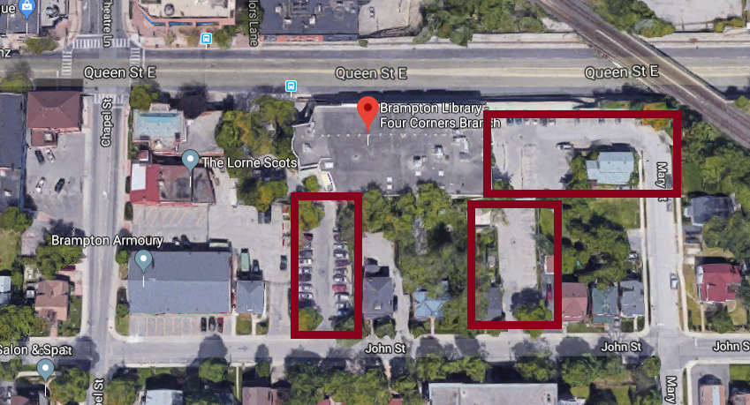
Program Location and parking
Location
Brampton Library - Four Corners Branch
65 Queen St E, Brampton or, Brampton, ON, L6W 3L6
Parking
As shown in the Picture
And, Make sure you come with fully charged windows or Mac computer with min 8 to 16 GB memory.
To come - Software preparation in your Laptop during preparation session 002 in 2 weeks.

Slide 13
Additional References
https://www.meetup.com/testoper/
https://join.slack.com/t/testoperworkspace/shared_invite/enQtNjQxNDUxMzA3Mzk5LWU3ZGNmMWE1NDgxYTU3ZTUyNWViODZhMzVlNmQ1MzVmYzM2NWQzOWY2ZDcwOWNkZTUxNDQ0NTY4ODQ3NjNhNjg
https://www.linkedin.com/groups/12273365/
https://www.linkedin.com/company/testoper/
https://github.com/testoper
https://twitter.com/Test_oper
https://www.facebook.com/Testoper-2259707950907991
https://www.eventbrite.com/o/testoper-community-28935529723
https://testoper.com/
Email: testoper@testoper.com , Ph: +1-647 998 1977
13

Slide 14

Q&A

